Slide 1
Repetition Control Structure
Chapter 5

Slide 2
Why is repetition needed?
Suppose you want to add five numbers to find their average. From what you have learned so far, you could write as follows:
cin >> num1 >> num2 >> num3 >> num4 >> num5;
sum = num1 + num2 + num3 + num4 + num5;
average = sum / 5.0;
What about if you want to add and average 100, 1000, or more numbers? You would have to declare that many variables and list them again in cin statements and, perhaps, again in the output statements.

Slide 3
Why is repetition needed?
We use repetition when you need to execute a block of code several number of times.
In general, statements are executed sequentially: The first statement in a function is executed first, followed by the second, and so on.
A loop statement allows us to execute a statement or group of statements multiple times.

Slide 4
Loops
C++ has three repetition, or looping, structures:
  for loop structure.
  while loop structure.
  do-while loop structure.

Slide 5
The for loop
A repetition control structure that allows you to repeat a set of statements a specific number of times.
Syntax:
for (initial statement; loop condition; update statement)
{
block of statements
}
No semicolon

Slide 6
How for loop executes?
The initial statement executes first. It initializes a variable called the loop control variable. This statements executes only once.
The loop condition is evaluated:
  If it is false → the body of the loop does not execute and flow of control jumps to the next statement just after the for loop.
  If it is true →
    Execute the body of the loop.
    Execute the update statement to update the loop control variable.
    Repeat Step 2 until the loop condition evaluates to false.

Slide 7
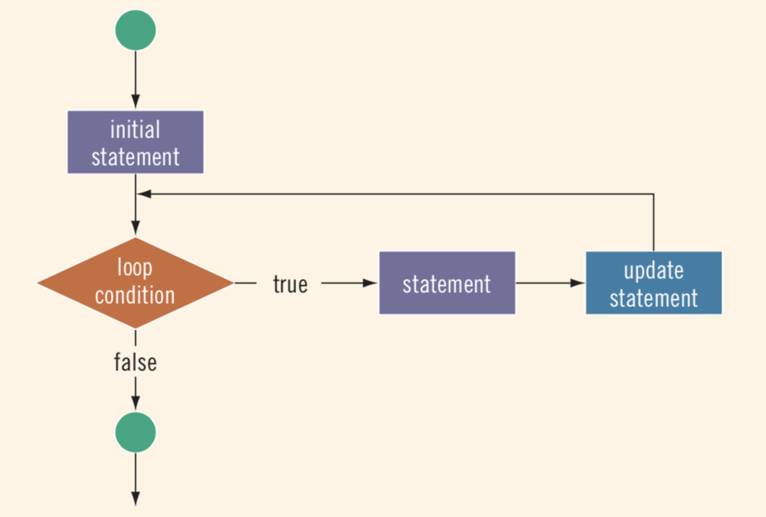
The for loop

Slide 8
The for statement
The initial value of the counter determines the first value to be used when executing the statements.
The loop repeats as long as the condition is true.
The step is the change (or update) in the value of the counter.
The loop counter should be always of type integer.
For example:
for ( i = 0; i < 5; i++ )
{
cout << i << “ “;
}
Initial value
Condition
Step

Slide 9
The for loop: Trace
Consider the following code fragment and let us trace it.
for (i = 0; i < 5; i++)
cout << i * 2 << endl;
Trace:
i++ | i < 5 ? | output
Initial value: 0 | 0 < 5 ? true | 0
1 | 1 < 5 ? true | 2
2 | 2 < 5 ? true | 4
3 | 3 < 5 ? true | 6
4 | 4 < 5 ? true | 8
5 | 5 < 5 ? false → exit from loop

Slide 10
The for loop: Trace
What will be the output if we modify the previous code fragment as follows:
for (i = 0; i <= 5; i++)
cout << i * 2 << endl;
Trace:
i++ | i < 5 ? | output
Initial value: 0 | 0 <= 5 ? true | 0
1 | 1 <= 5 ? true | 2
2 | 2 <= 5 ? true | 4
3 | 3 <= 5 ? true | 6
4 | 4 <= 5 ? true | 8
5 | 5 <= 5 ? true | 10
6 | 6 <= 5 ? false → exit from loop

Slide 11
The for loop: Counting backward
You can count backward using a for loop if the for loop control expressions are set correctly.
for (i = 5; i > 0; i--)
cout << i << endl;
Trace:
i-- | i > 0 ? | output
Initial value: 5 | 5 > 0 ? true | 5
4 | 4 > 0 ? true | 4
3 | 3 > 0 ? true | 3
2 | 2 > 0 ? true | 2
1 | 1 > 0 ? true | 1
0 | 0 > 0 ? false → exit from loop

Slide 12
The for loop: The update statement
You can increment (or decrement) the loop control variable by any fixed number.
In the following loop, i is incremented by 2
for (i = 1; i <= 20; i = i + 2)
cout << i << “ “;
What is the output of the above for loop?

Slide 13
The for loop: Compound statement
What is the difference between the following code fragments?
for (i = 1; i <= 5; i++) { cout << "Hello!" << endl; cout << "*" << endl; } | for (i = 1; i <= 5; i++) cout << "Hello!" << endl; cout << "*" << endl;
It outputs Hello! and a star (in a separate line) five times. Both output statements are a compound loop statements. Note the use of { }. | It prints Hello! five times and the star only once. The for loop control only the first output statement. The second statement is outside the loop.

Slide 14
The for loop: Examples
What is the output of the following code fragments?
Code | Output | Explanation
for (i = 10; i <= 9; i++) cout << i << " "; | No Output | The initial statement sets i to 10. Because initially the loop condition (i <= 9) is false, nothing happens.
for (i = 10; i <= 10; i++) cout << i << " "; | 10 | The loop condition (i <= 10) evaluates to true only once (The first time). After that it evaluates to false.

Slide 15
The for loop: Example
Write a complete program that calculates the factorial of an integer number n such that n is greater than zero.
Input?
n
Type?
integer
Value?
Through cin
Restriction?
n > 0
Output?
n!
1! = 1
2! = 2 x 1
3! = 3 x 2 x 1
4! = 4 x 3 x 2 x 1
5! = 5 x 4 x 3 x 2 x 1
n! = n * (n – 1) * (n – 2) * (n – 3) * … 1

Slide 16
The for loop: Example
n! = n * (n – 1) * (n – 2) * (n – 3) * … 1
Initial value: n
Step: -1
Condition: n >= 1
for (i = n; i >= 1; i--)
{
}

Slide 17
The for loop: Example
Code
#include <iostream> using namespace std; int main () { int n, i, fact = 1; cout << "Enter an integer number: "; cin >> n; for (i = n; i >= 1; i--) { fact = fact * i; } cout << “Factorial of “ << n << “ is “ << fact; }

Slide 18
The for loop: Example
What about if the entered number is less than 1?
Code
#include <iostream> using namespace std; int main () { int n, i, fact = 1; cout << "Enter an integer number: "; cin >> n; if (n >= 1) { for (i = n; i >= 1; i--) { fact = fact * i; } //end for cout << “Factorial of “ << n << “ is “ << fact; } //end if else cout << "Invalid input!"; }

Slide 19
The for loop: Example Trace
Trace the code with the input 1.
n | n >= 1 ? | i-- | i >= 1 ? | fact
-3 | -3 >= 1 ? false
Output: Invalid input!
n | n >= 1 ? | i-- | i >= 1 ? | fact
4 | 4 >= 1 ? true | Initial value: 4 | 4 >= 1 ? true | 1 * 4 = 4
 |  | 3 | 3 >= 1 ? true | 4 * 3 = 12
 |  | 2 | 2 >= 1 ? true | 12 * 2 = 24
 |  | 1 | 1 >= 1 ? true | 24 * 1 = 24
 |  | 0 | 0 >= 1 ? false
Output: Factorial of 4 is 24
if (n >= 1) {
for (i = n; i >= 1; i--) {
fact = fact * i; } //end for
cout << “Factorial of “ << n << “ is “ << fact; } //end if
else
cout << "Invalid input!";

Slide 20
The while loop
A repetition control structure that allows you to repeat a set of statements until certain conditions are met.
Syntax:
//initialize condition’s variable
while (condition) //test loop control variable
{
block of statements
//update condition’s variable
}

Slide 21
How while loop executes?
First, the expression is evaluated. If it evaluates to true, the body of the loop executes.
The expression is then re-evaluated. If it again evaluates to true, the body of the loop executes again.
The body of the loop continues to execute until the expression evaluates to false.
If the expression is false, program controls jumps to the next statement just after the loop.

Slide 22
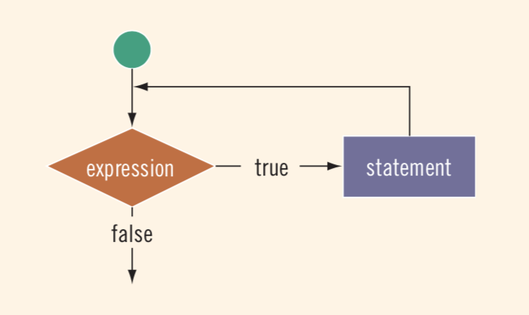
The while loop

Slide 23
The while loop
There are three types of while loop:
  Counter-controlled while loop.
  Sentinel-controlled while loop.
  Flag-controlled while loop.

Slide 24
Counter-controlled while loops
Used when you now exactly how many times certain statements need to be executed.
For loop can be converted to counter controlled while loop and vice versa:
for (int i = 0; i < 3; i++)
{
...
...
}
int i = 0;
while (i < 3)
{
...
i++
}

Slide 25
Counter-controlled while loops
Example1:
int i = 0; //loop control variable initialization
while (i <= 20) //while loop condition
{
cout << i << ” “;
i = i + 5; //update loop control variable to avoid infinite loop
}
i | i <= 20 ? | output | i = i + 5
Initial value: 0 | 0 <= 20 ? true | 0 | 5
5 | 5 <= 20 ? true | 5 | 10
10 | 10 <= 20 ? true | 10 | 15
15 | 15 <= 20 ? true | 15 | 20
20 | 20 <= 20 ? true | 20 | 25
25 | 25 <= 20 ? false → exit from loop

Slide 26
Counter-controlled while loops
Example2:
int i = 0;
while (i < 5) {
cout << i << “ “ << i * i;
i++; }
cout << “End of loop with i = “ << i;
i++ | i < 5 ? | output
Initial value: 0 | 0 < 5 ? true | 0 0
1 | 1 < 5 ? true | 1 1
2 | 2 < 5 ? true | 2 4
3 | 3 < 5 ? true | 3 9
4 | 4 < 5 ? true | 4 16
5 | 5 < 5 ? false → End of loop with i = 5

Slide 27
Loop control variable
The loop control variable i must be:
  Initialized before the loop (i = 0)
  Tested before the start of each loop iteration (i <= 5)
  Updated within the loop body in each iteration (i++)
int i = 0;
while (i <= 5)
{
cout << i << endl;
i++;
}

Slide 28
for loop vs. while loop
When we know how many iterations we need to repeat a block of statements, we use the for loop.
When we don’t know how many iterations we need to repeat a block of statements, the “for” loop CANNOT be used and in this case, we can use the “while” loop.
A “while” loop can replace a “for” loop.

Slide 29
for loop vs. while loop
Consider the difference between the following code fragments:
for | while
int hours, count_emp; float rate, pay; for (count_emp = 0; count_emp < 7; count_emp++) { cout << "Hours: "; cin >> hours; cout << "Rate: "; cin >> rate; pay = hours * rate; cout << "Pay is " << pay << " SR" << endl; } // end of for loop cout << "All employees processed"; | int hours, count_emp; float rate, pay; count_emp = 0; while (count_emp < 7) { cout << "Hours: "; cin >> hours; cout << "Rate: "; cin >> rate; pay = hours * rate; cout << "Pay is " << pay << " SR" << endl; count_emp++; } // end of for loop cout << "All employees processed";

Slide 30
Computing sum and product in a loop
Loops often accumulate a sum or a product by repeating an addition or a multiplication.
Accumulate sum: sum = sum + value
Accumulate product: product = product * value
Let us return to the previous example, and calculate the total amount of the company’s pay.

Slide 31
Computing sum and product in a loop
int count_emp = 0;
int total_pay = 0; //accumulator variable initialized
while (count_emp < 7)
{
cout << "Hours: ";
cin >> hours;
cout << "Rate: ";
cin >> rate;
pay = hours * rate;
cout << "Pay is " << pay << " SR" << endl;
count_emp++;
total_pay = total_pay + pay;
} // end of for loop
cout << "All employees processed" << endl;
cout << "total payroll is " << total_pay << " SR";
After calculating pay, the program adds it to the sum of all pay calculated before.

Slide 32
Computing sum and product in a loop
In this example, we don’t know how many iterations will be executed.
Write a complete program that multiplies integer numbers (read by user) as long as the product is less than 10,000.
Input?
numbers to be multiplied
Type?
int
How to get their values?
cin
Condition?
product < 10000

Slide 33
Computing sum and product in a loop
#include <iostream>
using namespace std;
int main ()
{
int number;
int product = 1; //initialize the loop control variable
while (product < 10000)
{
cout << "Enter an integer: ";
cin >> number;
product *= number; // product = product * number;
}
cout << "Product " << product << " exceeds 10000!";
}

Slide 34
Validating user entry
In order to have full control over programs, we must make sure that the user enters valid data.
However, we cannot know how many times the user will enter invalid data.
For example, if the program asks the user to enter a number of students, the user may enter a negative number.
The following code fragment uses a while loop to validate the user entry:
int numOfStudents;
cout << "Enter the number of students: ";
cin >> numOfStudents;
while (numOfStudents < 0) {
cout << "Enter the number of students: ";
cin >> numOfStudents; }

Slide 35
Sentinel-controlled while loops
You do not always know how many pieces of data need to be read, but you may know that the last entry is a special value, called a sentinel.
The sentinel value should be selected carefully so it is not part of the data read.

Slide 36
Sentinel-controlled while loops
The general syntax is:
How it works?
  You read the first item before the while statement.
  If this item does not equal the sentinel, the body of the while statement executes.
  The while loop continues to execute as long as the program has not read the sentinel.
cin >> variable; //initialize the loop control variable
while (variable != sentinel) //test the loop control variable
{
…
cin >> variable; //update the loop control variable
…
}

Slide 37
Sentinel-controlled while loops: Example
The instructor may not know the exact number of students who took the exam.
Therefore, we use a sentinel to mark the end of the data entry.
The sentinel value should be a number that is impossible to occur as part of data.
Therefore, we’ll make it as negative number.
Since some scores may be still negative, we’ll choose a very big number in negative (very small in value).
Of course, the sentinel should be the same type as the entered data.
Write a complete program that calculates the sum of a collection of exam scores.

Slide 38

Sentinel-controlled while loops: Example
In this program, we’ll select -999 as our sentinel.
int score;
int sum = 0; // will be used as an accumulator
const int SENTINEL = -999;
cout << "Enter first score (or " << SENTINEL << " to quit): ";
cin >> score;
while (score != SENTINEL)
{
sum += score;
cout << "Enter next score (or " << SENTINEL << " to quit): ";
cin >> score;
}
cout << "Sum of exam scores is " << sum;

Slide 39
Flag-controlled while loops
A flag-controlled while loop uses a bool variable to control the loop.
The general syntax is:
found = false; //initialize the loop control variable (flag variable)
while (!found) {
.
.
if (expression)
found = true; //update the loop control variable.
.
.
}

Slide 40
Flag-controlled while loops : Example
Consider the following code that sums a number of positive integers until the user enters a negative number.
#include<iostream>
using namespace std;
int main() {
int sum = 0.0;
int value;
bool nonNegative = true; // initialize flag
while(nonNegative) { // Test if nonNegative is true
cin >> value;
if(value < 0)
nonNegative = false;
else
sum += value;
}
cout << "Sum of input numbers is " << sum; }

Slide 41
The do while loops
The do while executes the body loop then it evaluates the condition.
The do while statement is used in case you want the loop body to execute at least once.
Syntax:
do
{
Block of statements
}
While (expression);
Note the semicolon here

Slide 42
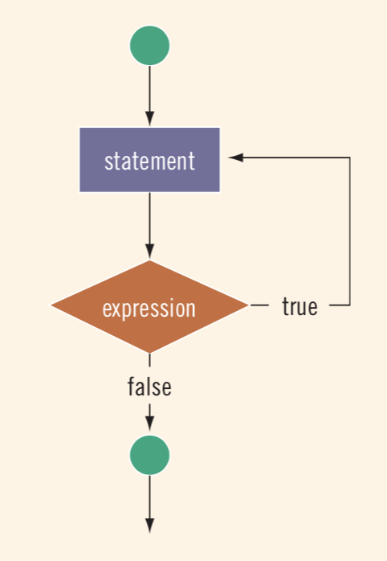
The do while loops
First, the statement executes.
Then, the expression is evaluated: If the expression evaluates to true, the statement executes again.
As long as the expression in a do...while statement is true, the statement executes.

Slide 43
The do while loops: Example
Consider a program that displays a menu, and reads the input from the user.
Since the menu should be displayed to the user at least once → Use do while
// Display a menu
cout << "F: First Class" << endl;
cout << "B: Business" << endl;
cout << "E: Economy" << endl;
// Instruct the user to enter his option
cout << "Enter the passengers code: ";
cin >> code;

Slide 44
The do while loops: Example
An option should be also added as a SENTINEL to exit from the loop.
do
{
// Display a menu
cout << "F: First Class" << endl;
cout << "B: Business" << endl;
cout << "E: Economy" << endl;
cout << "X: to exit" << endl;
// Instruct the user to enter his option
cout << "Enter the passengers code: ";
cin >> code;
}
while ((code != 'X') &&(code != 'x'));

Slide 45
The do while loops: Complete solution
#include <iostream>
using namespace std;
int main ()
{
char code;
float numOfPassengers, amount_due;
do
{
// Display a menu
cout << "F: First Class" << endl;
cout << "B: Business" << endl;
cout << "E: Economy" << endl;
cout << "X: to exit" << endl;
// Instruct the user to enter his option
cout << "Enter the passengers code: ";
cin >> code;
cout << "Enter the number of
passengers: ";
cin >> numOfPassengers;
switch (code)
{
case 'F': amount_due = 1500 * numOfPassengers;
break;
case 'B': amount_due = 900 * numOfPassengers;
break;
case 'E': amount_due = 500 * numOfPassengers;
break;
case 'X': case 'x': amount_due = 0;
break;
default: cout << "Invalid Input" << endl;
amount_due = 0;
break;
} //end switch
cout << "Due amount = " << amount_due << endl;
} //end while
while ((code != 'X') &&(code != 'x'));
} //end main

Slide 46
for vs. while vs. do while
for | while | do while
evaluate the condition before deciding to execute the loop body or not. | evaluate the condition before deciding to execute the loop body or not. | executes the loop body then evaluates the condition to check if it should be re-executed or not.
Use for if you know the number of iterations. | Use while if you don’t know the number of iterations. | Use do while if you don’t know the number of iterations.
A problem solved with for, can also be solved using while.

Slide 47
Infinite loops
Infinite loop: A loop that continues to execute endlessly, i.e. the condition is always satisfied (true).
To avoid an infinite loop, make sure that the loop’s body contains statement(s) that assure that the loop condition will be false.
Example:
i = 1;
while (i <= 10)
{
cout << i << " ";
}
What could be added to avoid the infinite loop?

Slide 48
Nested loops
Nested loops: Consist of an outer loop with one or more inner loops
Each time the outer loop is repeated, the inner loop starts from the beginning.

Slide 49
Nested loops : Simple example
int i, j;
for ( i= 0; i < 2; i++) {
for (j = 0; j < 3; j++)
cout << " i = " << i << ", j = " << j << endl; }
i++ | i < 2 ? | j++ | j < 3 | output
Initial value: 0 | 0 < 2 ? true | Initial value: 0 | 0 < 3 ? true | i = 0, j = 0
 |  | 1 | 1 < 3 ? true | i = 0, j = 1
 |  | 2 | 2 < 3 ? true | i = 0, j = 2
 |  | 3 | 3 < 3 ? False → exit inner loop
1 | 1 < 2 ? true | Initial value: 0 | 0 < 3 ? true | i = 1, j = 0
 |  | 1 | 1 < 3 ? true | i = 1, j = 1
 |  | 2 | 2 < 3 ? true | i = 1, j = 2
 |  | 3 | 3 < 3 ? False → exit inner loop
2 | 2 < 2 ? False → exit outer loop

Slide 50
Nested loops: Example 1
Write a complete program that produces the following output:
Analysis:
We need two counters:
  The first counter line counts the lines from 1 to 5
  The second counter asterisks counts the number of asterisks in each line
*
**
***
****
*****

Slide 51
Nested loops: Example 1
Line | Asterisks
1 | 1
2 | 1
 | 2
3 | 1
 | 2
 | 3
4 | 1
 | 2
 | 3
 | 4
5 | 1
 | 2
 | 3
 | 4
 | 5
line is the counter of the outer loop, and asterisks is the counter of the inner loop.
line:
Initial value: 1
Final value: 5 ➔ condition is (line <= 5)
Step: +1
asterisks:
Initial value: 1
Final value: line ➔ condition is (asterisks <= line)
Step: +1

Slide 52
Nested loops: Example 1
#include <iostream>
using namespace std;
int main ()
{
int line, asterisks;
for (line = 1; line <= 5; line++)
{
for (asterisks = 1; asterisks <= line; asterisks++)
cout << "*";
cout << "\n";
} // end line
return (0);
} // end of main

Slide 53
Nested loops: Example 2
Each student has five courses and each course has three exams. Write a program that reads three exam scores from user for each course and then calculates and prints the total mark of each course. Suppose that you have 100 students.
Analysis:
  Calculate total mark for each course.
  Repeat calculation for five courses.
  Repeat step 1 and 2 for 100 students.

Slide 54
Nested loops: Example 2
Calculate the total score of a student in one course.
#include <iostream>
using namespace std;
int main ()
{
float score, total;
int exam; //exam counter
for (exam = 1; exam <= 3; exam++)
{
cout << "Enter student’s score for exam #" << exam << ": ";
cin >> score;
total += score;
} // end exams
cout << "Total score for student is " << total << endl;
} //end main

Slide 55
Nested loops: Example 2 (cont.)
Repeat the same calculation for five courses.
#include <iostream>
using namespace std;
int main () {
float score, total;
int ID;
int exam; //exam counter
int course; //course counter
for (course = 1; course <= 5; course++) {
total = 0.0;
cout << "Course # " << course << endl;
for (exam = 1; exam <= 3; exam++) {
cout << "Enter student’s score for exam #" << exam << ": ";
cin >> score;
total += score;
} //end exams
cout << "Total score for student in course #" << course << " is " << total << endl;
} // end courses
} //end main

Slide 56
Nested loops: Example 2 (cont.)
Repeat the same steps for 100 students.
#include <iostream>
using namespace std;
int main () {
float score, total;
int ID;
int exam; //exam counter int course; //course counter int student; //student counter
for (student = 1; student <= 100; student++)
{
cout << "Enter Student ID: ";
cin >> ID;
for (course = 1; course <= 5; course++). {
total = 0.0; // initialize the accumulator for every student
cout << "Course # " << course << endl;
for (exam = 1; exam <= 3; exam++) {
cout << "Enter student’s score for exam #" << exam << ": ";
cin >> score;
total += score; } //end exams
cout << "Total score for student in course #" << course << " is " << total << endl;
} // end courses
} // end students
} //end main

Slide 57
The break statement: Revisited
As have seen, the break statement, when executed in a switch structure, provides an immediate exit from the switch structure.
switch (op) {
case '+':
result = n1 + n2;
break;
case '*':
result = n1 * n2;
break;
case '/':
result = n1 / n2;
break;
default:
cout << "Invalid input!";
break; }
cout << "Result is: " << result;

Slide 58
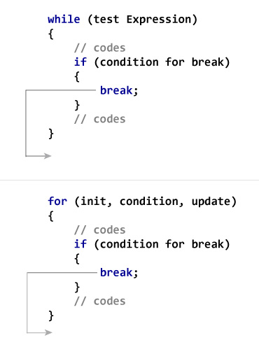
The break statement within loops
The break statement may be executed in a for, while, do while, and switch commands.
In all cases, it causes an immediate exit from that statement.
Execution continues with the next statement immediately.
Therefore, a break statement is used to exit early from a loop or to skip the remainder of the switch structure.
In general, a break statement is executed after checking a specific condition in a loop. Therefore, it is found with an if statement.

Slide 59
The break statement within loops : Example 1
Consider the following code:
#include <iostream>
using namespace std;
int main () {
int x; // to be used as a counter
for (x = 1; x <= 10; x++) {
if (x == 5)
break; // break loop only when x equals 5
cout << x;
} // end for
cout <<”\nBroke out of loop at x equals ” << x;
}
Output | 1 2 3 4 Broke out of loop at x equals 5

Slide 60
The break statement within loops : Example 2
Consider the following code:
#include <iostream>
using namespace std;
int main () {
int sum = 0, x, number;
for (x = 1; x <= 10; x++)
{
cout << "Enter an integer, 0 exits the program: ";
cin >> number;
if (number == 0)
break; // break loop only when user enters 0
sum += number; // executes if number != 0
} // end for
cout << "sum = " << sum; } // end of main

Slide 61
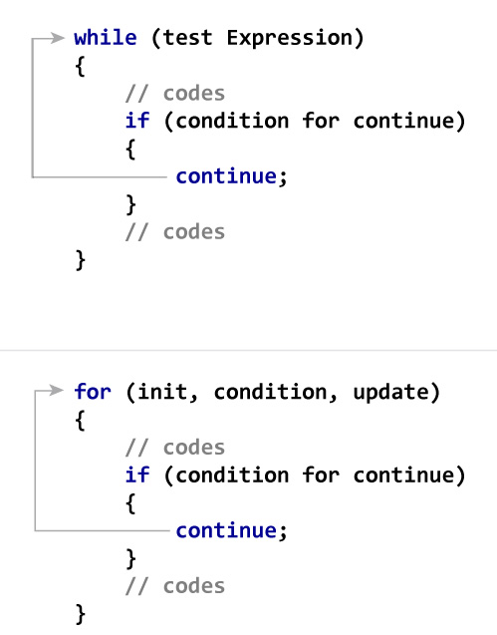
The continue statement
The continue statement is executed within a for, while, do while loops.
In all cases, it skips the remaining statements in the loop and proceeds with the next iteration of the loop.
In a while and do while structure, the loop condition is evaluated immediately after the continue statement. In a for structure, the update statement is executed after the continue statement, and then the loop condition executes.
Like the break statement, it is generally coupled with an if statement.

Slide 62
The continue statement: Example 1
Consider the following code:
#include <iostream>
using namespace std;
int main () {
int x;
for (x = 1; x <= 10; x++). {
if (x == 5)
continue; // restart a new iteration
cout << x << “ ”;
} // end for
cout <<"\nUsed continue to skip printing the value 5.";
}
Output | 1 2 3 4 6 7 8 9 10 Used continue to skip printing the value 5.

Slide 63
The continue statement: Example 2
Write a complete program that outputs the sum of odd numbers, and the sum of even numbers. If the number is negative skip it. The user should enter 0 to end his data entry.
How to recognize that a number x is even?
x % 2 = 0
How to recognize that a number x is odd?
x % 2 != 0
How to recognize that a number x is positive?
x > 0
How to recognize that a number x is negative?
x < 0

Slide 64
The continue statement: Example 2
Write a complete program that outputs the sum of odd numbers, and the sum of even numbers. If the number is negative skip it. The user should enter 0 to end his data entry.
The user should enter 0 to end his data entry.
While (x != 0)
If the number is negative skip it
If (x < 0) continue;

Slide 65
Example on the while loop
#include <iostream>
using namespace std;
int main () {
int number = -1; // initialize with a non-zero value to enter the loop
int sum_odd = 0, sum_even = 0;
while (number != 0) {
cout << "Enter number: ";
cin >> number;
if (number < 0)
continue;
if (number % 2 == 0)
sum_even += number;
else
sum_odd += number;
} // end while
cout << "Sum odd = " << sum_odd << ", Sum even = " << sum_even;
}

